Slide 1
Simple Sentences and Fragments
8th Writing - Grammar

Slide 2
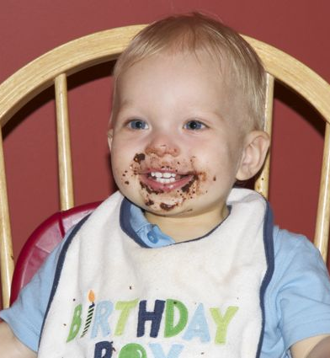
SIMPLE SENTENCE
One independent clause
MAY contain any number of phrases
CANNOT contain dependent clauses
Example: I enjoyed eating cake on my birthday.
Independent Clause Prepositional Phrase

Slide 3
Examples
Look at the following examples. All of them are simple sentences. Underline the IC once, and the phrases twice.
My amazing teacher never gave us homework on the weekend.
The dog barked.
After school on Friday, I went to the movies with my friends.
The bell rang loudly.
Now try two on your own:
Before class, I always chat with my friends in the hall.
My mom cooks amazing dinners.
Independent Clause Prepositional Phrase
Independent Clause
Prepositional Phrase Independent Clause Prepositional Phrase
Independent Clause

Slide 4
CAUTION!
Common Sentence
Error Ahead!

Slide 5
Sentence Fragments
A phrase or dependent clause standing on its own
(Basically, it’s anything masquerading as a sentence when it isn’t one!)
EXAMPLES:
Falling asleep at my desk.
Although I love the park.
The man that was running down the street.
Fix it:
Add a subject
Add a predicate (verb)
Add an independent clause

